Slide 1
SRI RAMAKRISHNA ENGINEERING COLLEGE
[Educational Service : SNR Sons Charitable Trust]
[Autonomous Institution, Accredited by NAAC with ‘A’ Grade]
[Approved by AICTE and Permanently Affiliated to Anna University, Chennai]
[ISO 9001-2015 Certified and all eligible programmes Accredited by NBA]
VATTAMALAIPALAYAM, N.G.G.O. COLONY POST, COIMBATORE – 641 022.
Department of Electronics and Communication Engineering
16EC253-MINIPROJECT I
No. of Credits : 2

Slide 2
SRI RAMAKRISHNA ENGINEERING COLLEGE
Class / Section / Semester | : | II ECE / B / III
Batch | : | 04
Project Review | : | Fourth Review
Title of the project | : | Stock Value Prediction Using Deep Learning
Date | : | 16.06.2021
Project Guide | : | Mr. E Esakki Vigneswaran, Assistant Professor (Sr.G)/ECE
Team Members | : | Karthik.K (1902102) Nithin Soundar S.J(1902132) 3. Rithick Roshan.R(1902156)

Slide 3
OVERVIEW
S.NO | CONTENTS | SLIDE NO.
1 | CHALLENGE STATEMENT | 4
2 | LITERATURE SURVEY | 5,6,7
3 | EXISTING METHOD | 8
4 | PROPOSED METHOD | 9
5 | BLOCK/SCHEMATIC DIAGRAM | 10
6 | USE-CASE DIAGRAM | 11
7 | SOFTWARE IMPLEMENTATION | 12
8 | PSEDUOCODE FOR PREDICITION ALGORITHM | 13
9 | SOFTWARE SIMULATION VIDEO | 14
10 | OUTPUT | 15
11 | COMPARISION | 16,17,18
12 | COMARISION TABLE | 19
13 | CONCLUSION | 20
14 15 | FUTURE SCOPE REFERENCES | 21 22

Slide 4
CHALLENGE STATEMENT
Prediction of Stock values
Minimize false positive prediction from the trend
prediction with existing algorithms

Slide 5
LITERATURE SURVEY
S.NO | TITLE | AUTHOR | NAME OF THE ORGANIZATION & YEAR | DESCRIPTION
1 | Predicting Stock Market Trends Using Machine Learning and Deep Learning Algorithms Via Continuous and Binary Data ; a Comparative Analysis | Mojtaba Nabipour, Pooyan Nayyeri | IEE,2020 | Results show that in the binary data evaluation, those deep learning methods are the best
2 | Application of Deep Learning in Stock Market Valuation Index Forecasting | Ge Li, Ming Xiao | IEEE 10th International Conference on Software Engineering and Service Science IEEE,2019 | Deep learning is the core technology of artificial intelligence, which has higher accuracy than traditional algorithms. Due to high-risk and high-yield in stock market investors hope to make predictions on it, so as to reduce investment risks.

Slide 6
LITERATURE SURVEY
S.NO | TITLE | AUTHOR | NAME OF THE ORGANIZATION & YEAR | DESCRIPTION
3 | Prediction of Stock Prices using Machine Learning (Regression, Classification) Algorithms | Srinath Ravikumar, Prasad Saraf | 2020 International Conference for Emerging Technology (INCET). Year: 2020 | The stock price and momentum of Apple stock dataset was predicted and the accuracies of the various machine learning models were compared and analysed..
4 | Stock market prediction using machine learning techniques | Mehak Usmani, Syed Hasan Adil | 3rd International Conference on Computer and Information Sciences (ICCOINS) Year: 2016 | The prediction model uses different attributes as an input and predicts market as Positive & Negative.

Slide 7
LITERATURE SURVEY
S.NO | TITLE | AUTHOR | NAME OF THE ORGANIZATION & YEAR | DESCRIPTION
5 | Automated Trading System for Stock Index Using Neural Networks and Risk Management | halita R.Silva, Audeliano W. Li | International Joint Conference on Neural Networks (IJCNN) Year: 2020 | In this paper, an automated trading system is built to predict future trends of stock index prices.

Slide 8
EXISTING METHOD
Deep learning has higher accuracy than traditional algorithms.
Existing methods predict stock market values as positive or negative at the end of the day.
Deep Neural Network and Radial Basis Function Neural Network are used in existing methods.
The proposed LSTMs have an improved accuracy of 4.8% over RBFNN

Slide 9
PROPOSED METHOD
In the proposed method, we propose the usage of Long Short Term Memory cells.
LSTM are mini neural networks designed for larger neural networks.
These LSTMs at every feed forward iteration the cell can hold onto information from the previous step, as well as all previous steps.

Slide 10
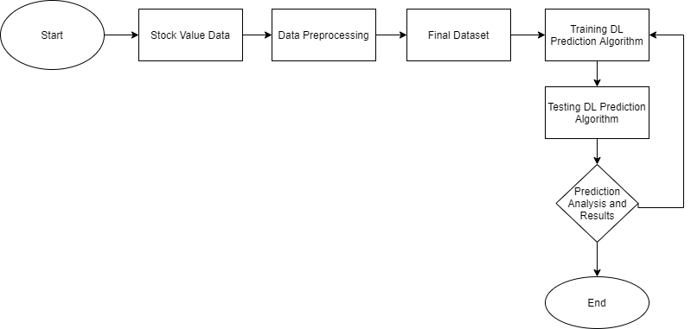
BLOCK / SCHEMATIC DIAGRAM

Slide 11
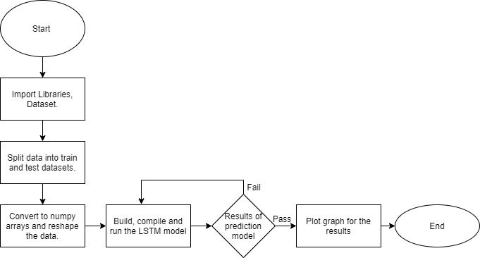
USE CASE DIAGRAM

Slide 12
SOFTWARE IMPLEMENTATION
Software:
Deep Learning(LSTM)-Long Short Term Memory networks – are a special kind of RNN, capable of learning long-term dependencies. Remembering information for long periods of time is practically their default behaviour.
Python
Google Colab - Colab allows anybody to write and execute arbitrary python code through the browser, and is especially well suited to machine learning, data analysis and education.
03-07-2021

Slide 13
PSEDUOCODE FOR PREDICITION ALGORITHM
Import Libraries.
Import dataset.
Data summary and check for missing values. Drop the rows with any null values.
Plot a graph for Close price history of period vs close price graph.
Scale and transform the target and features column using MinMaxScaler.
Function to split dataset into Train and Test Dataset.
Convert the x_train and y_train to numpy arrays. After the conversion, reshape the data.
Build the LSTM model. Compile the model. Train the model.
Prediction on Train and Test data.
Plot a graph for Prediction Model of period vs close price.
03-07-2021

Slide 14
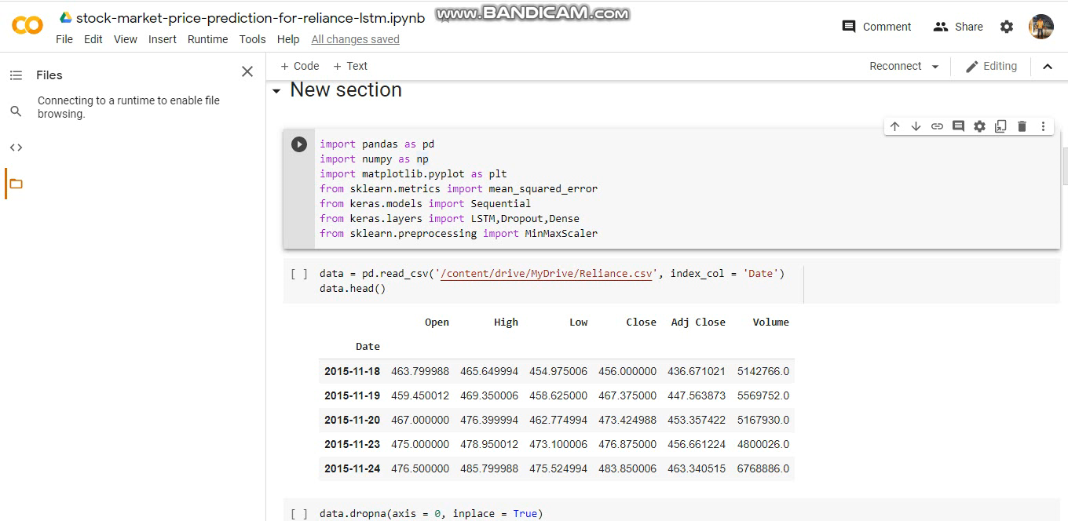
SOFTWARE SIMULATION VIDEO

Slide 15
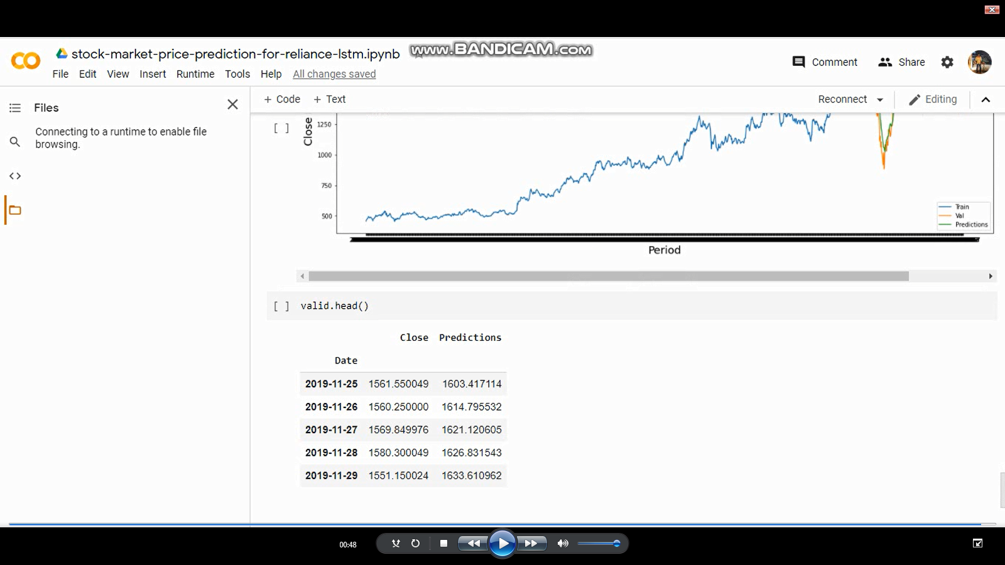
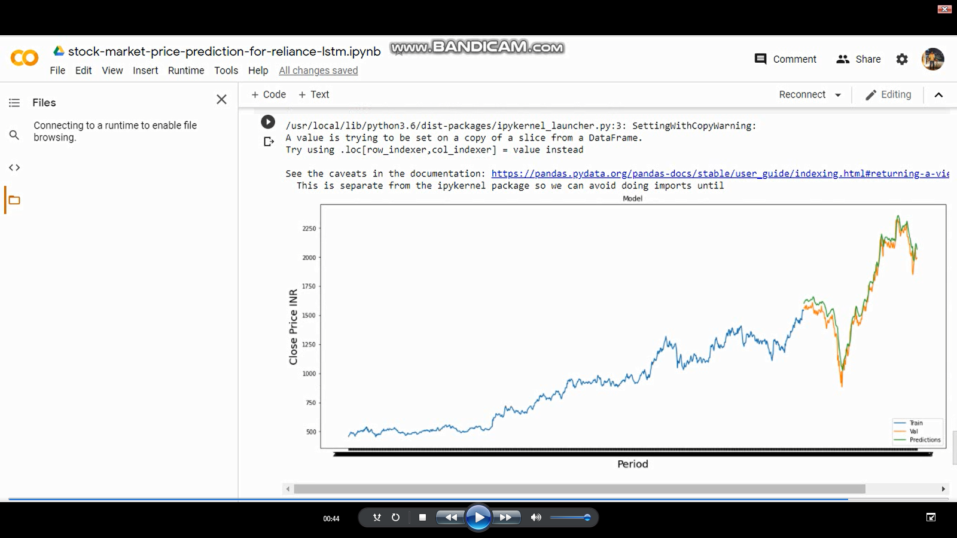
OUTPUT- epochs 3
03-07-2021
MP-I
15

Slide 16
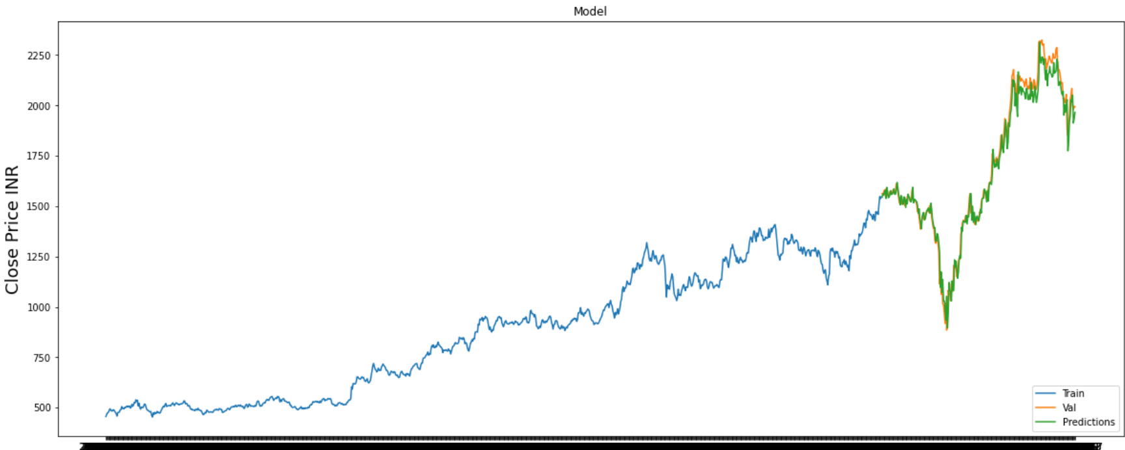
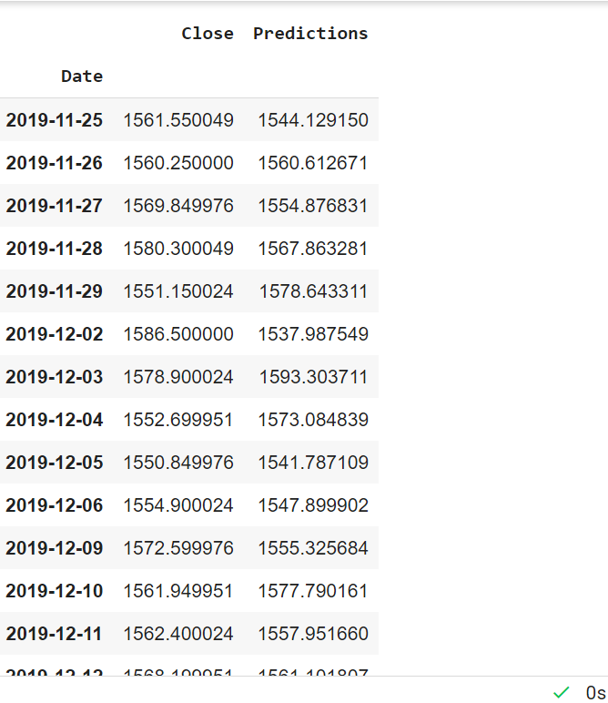
OUTPUT- epochs 20

Slide 17
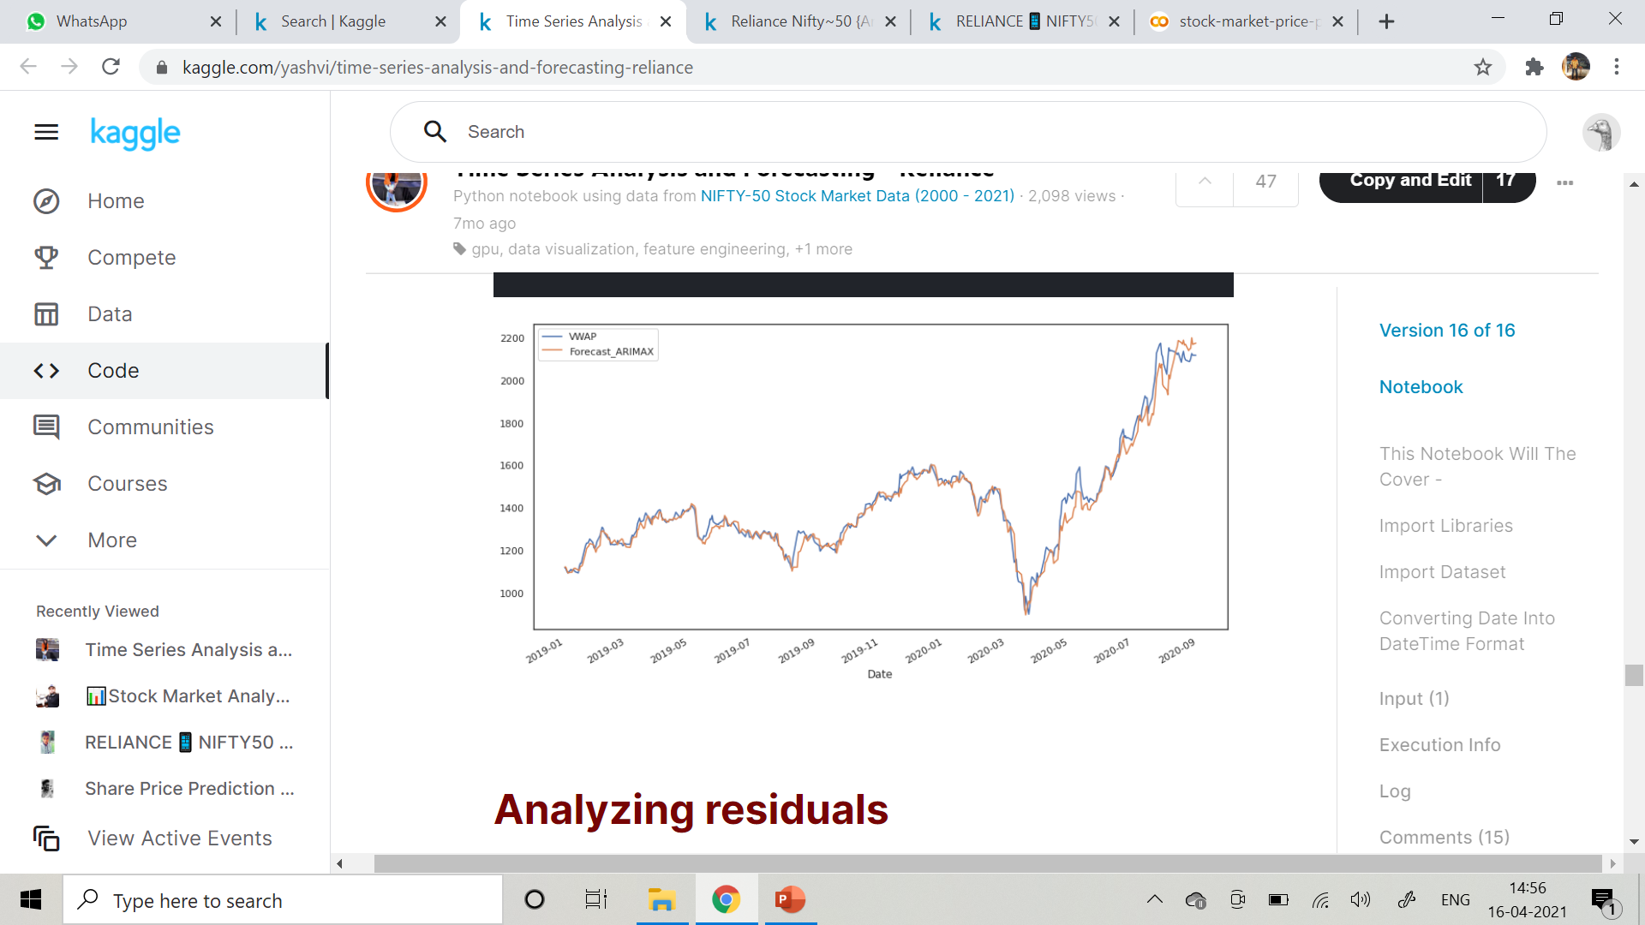
COMPARISION
Output of Stock values of Reliance Using Time Series Model

Slide 18
COMPARISION TABLE
S.No | MODEL | COMPANY | RMS ERROR | ACCURACY SCORE
1 | LSTM | Reliance | 55.18764281612258 | 0.968
2 | Time Series Analysis | Reliance | 90.77775126216939 | 0.926
03-07-2021
MP-I
18

Slide 19
CONCLUSION
Predicting stock market returns is a challenging task due to consistently changing stock values which are dependent on multiple parameters which form complex patterns.
After comparing various algorithms, LSTM model proved to be better in sequence prediction problems.
This work consists of two parts: data extraction and pre-processing of the Reliance stock market dataset, and stock price trend prediction model based on the long short-term memory (LSTM).
The stock values of Reliance were pre-processed, and the data was split into training and testing data. This data was fed into the training algorithm and results were obtained

Slide 20
FUTURE WORK
For future work, deep learning models could be developed which consider financial news articles along with financial parameters such as a closing price, traded volume, profit and loss statements etc., for possibly better results.

Slide 21
REFERENCES
Nabipour, Mojtaba & Nayyeri, Pooyan & Jabani, Hamed & Band, Shahab & Mosavi, Amir. (2020). Predicting stock market trends using machine learning and deep learning algorithms via continuous and binary data; a comparative analysis on the Tehran stock exchange. IEEE Access. PP. 1-1. 10.1109/ACCESS.2020.3015966.
G. Li, M. Xiao and Y. Guo, "Application of Deep Learning in Stock Market Valuation Index Forecasting," 2019 IEEE 10th International Conference on Software Engineering and Service Science (ICSESS), 2019, pp. 551-554, doi: 10.1109/ICSESS47205.2019.9040833.
S. Ravikumar and P. Saraf, "Prediction of Stock Prices using Machine Learning (Regression, Classification) Algorithms," 2020 International Conference for Emerging Technology (INCET), 2020, pp. 1-5, doi: 10.1109/INCET49848.2020.9154061.
M. Usmani, S. H. Adil, K. Raza and S. S. A. Ali, "Stock market prediction using machine learning techniques," 2016 3rd International Conference on Computer and Information Sciences (ICCOINS), 2016, pp. 322-327, doi: 10.1109/ICCOINS.2016.7783235.,
T. R. Silva, A. W. Li and E. O. Pamplona, "Automated Trading System for Stock Index Using LSTM Neural Networks and Risk Management," 2020 International Joint Conference on Neural Networks (IJCNN), 2020, pp. 1-8, doi: 10.1109/IJCNN48605.2020.9207278.

Slide 22
THANK YOU

